Slide 1
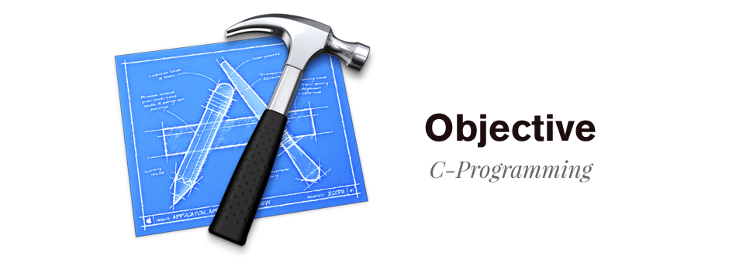
Sua.le@gameloft.com

Slide 2
Content
1
Getting Started
2
OOP with Objective-C
3
Memory Management
4
Introduction to Foundation Kit
5
Mixing Objective-C with C++

Slide 3
GETTING STARTED

Slide 4
Introduction to objective-c
- The primary programming language to writing software for OSX & iOS
- A superset of the C programming language.
- Object-oriented capabilities and a dynamic runtime
- Supports for object graph management, providing dynamic typing and binding, deferring many responsibilities until runtime.

Slide 5

ENvironment
- Objective-C uses CLANG as primary compiler. It supports for the C, C++, Objective-C and Objective-C++.
- We usually use xCode to write Objective-C and develop Mac OSX, iOS application.
Image: XCODE logo

Slide 6
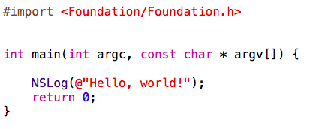
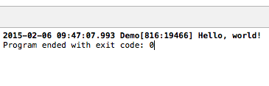
HELLO, WORLD
Use foundation framework
Entry point
Print to console screen

Slide 7
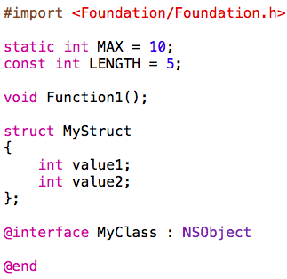
Objective-C files
*.H FILE
- Header file
- Hold the declarations of elements such as structs, classes, constants, satic variable and function prototypes.
- Not complied
- Using for import or include to .m files.

Slide 8
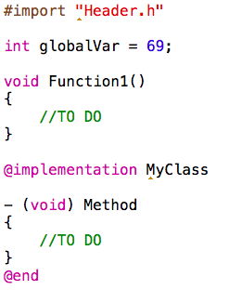
Objective-C files (CONT)
*.M FILE
- Source file
- Hold implementation functions, structs, classes, declaration variables, etc.
- Complied

Slide 9
Build process
Source .h/.m
Preprocess
Preprocessed source (.m, *.mm)
Complie
Module obj file
Linker
Executable file

Slide 10
Objective-c datatye
+ Non-Object type
Include C primitive datatype, struct, enum, pointer
Example: int, float, char, NSInterge, NSFloat, NSPoint, void *, etc.
+ Object type
Objective-C class, inherit from NSObject
Example: NSString, NSNumber, NSArray, MyClass, etc.

Slide 11
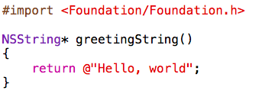
FUNCtion
+ Global function
<return-type> functionName(argument list)
{
/*body*/
return someValue;
}
Example:

Slide 12
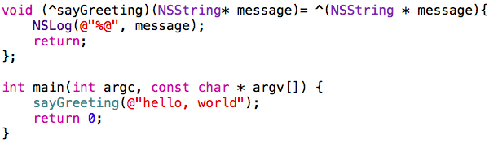
Function (cont)
+ Block function
<return-type> (^blockName) (<argument list>) = ^ (<argument list>){
/*body of block function*/
}
Example:

Slide 13
OOP with Objective-C

Slide 14
Defining classes
+ There are 2 parts
Interface part
Implementation part
+ Must inherit from NSObject class

Slide 15
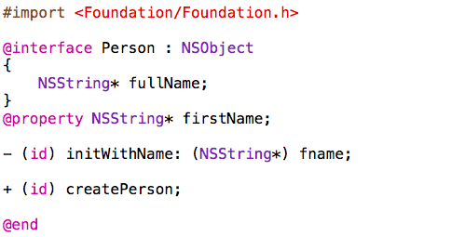
interface part
Inherit from NSObject
Instance variable
Instance property
Instance method
Class method

Slide 16
interface part (cont)
+ Properties and Instance variable are variable members of class
+ The syntax to declare a method:
sign (dataType) someMethod;
sign (dataType) otherMethodWithParam1: (dataType) param1 andParam2: (dataType) param2;
+ Sign type:
“+” for class method or static method
“-” for instance method or non-static method
+ Don’t actually support class’s static member

Slide 17
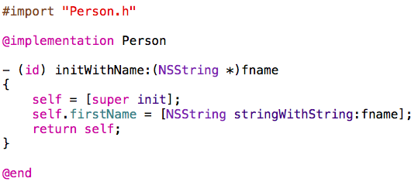
Implementation part
Import interface part
Method implementation

Slide 18
Implementation part (Cont)
+ “id” means some kind of object
+ “self” like “this” in C++ or Java, which is a pointer point to itself
+ “super” means super class or base class.
+ You can implement a method without declare at interface part.

Slide 19
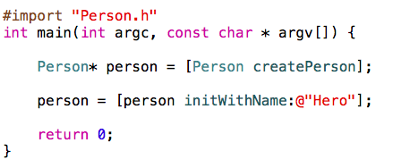
Working with objects
+ Invoke a method or send a message:
[someObject someMethod];
[someObject otherMethodWithPrama1: param1 andParam2: param2];
[SomeClass classMethod]
Example:
Send a message to class
Send a message to person instance

Slide 20
Dynamic allocation an object
+ An Objective-C object must be created by using dynamic allocation.
+ We use ‘alloc’ combine with “init” method or “new” to create an object
NSObject* newObect = [[NSObject alloc] init];
Or NSObject* newObject = [NSObject new];
+ When an object is destroyed, “delloc” method will be automatically called.
(void) delloc;

Slide 21
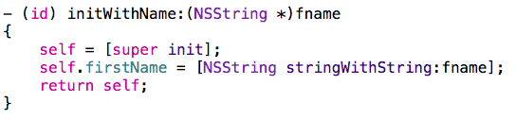
Dynamic allocation an object (CONT)
+ You can override “init” method or “delloc” to initialize or destroy an object.
+ The initializer method can take arguments:
(id) initWithBool: (BOOL) value;
(id) initWithName: (NSString*) name;
Example:
Remember to call self = [super init] first of all, when override the initializer method

Slide 22
ENCapsulating data
+ By default, all properties and methods is declared in interface part are complete public access.
+ Method is implemented without declare in interface part only use inside implementation part of class.
@interface Person: NSObject
@properties NSString * firstName;
@properties NSString * lastName;
@end
NSString* firstName = [somePerson firstName];
[somePerson setFirstName: @”John”];
The accesor method are synthesized automatically for you by the compiler.

Slide 23
ENCapsulating data (CONT)
+ @public, @private, @protected for instance variable
+ You can access public instance variable like this:
@interface Person: NSObject
{
@private NSString* firstName;
@protected NSString* lastName;
@public NSString* fullName;
}
@end
Person* person = [Person new];
NSString* name = person->fullName

Slide 24
ENCapsulating data (CONT)
+ If you don’t want to allow property to be changed via setter method (default is readwrite)
+ Customizing accessor for properties by using setter/getter:
@interface Person: NSObject
@properties (readonly) NSString * firstName;
@end
[somePerson setFirstName: @”John”]; → cause error!!
@interface Person: NSObject
@properties (getter=isFinished) BOOL finished;
@end

Slide 25
ENCapsulating data (CONT)
+ Customizing synthesized instance variable names
+ By default, a property is synthesized instance variable names with the same name, with an undersocre prefix “_”
@interface Person: NSObject
{
NSString* name;
}
@properties (readonly) NSString * firstName;
@end
@implementation Person
@synthesized firstName = name;
@end

Slide 26
ENCapsulating data (CONT)
- You can synthesize instance variable names with the same name
@implementation Person
(void) someMethod {
_firstName = @”Johny”; // ~ self.firstName = @”Johny”
}
@end
@interface Person: NSObject
@properties (readonly) NSString * firstName;
@end
@implementation Person
@synthesized firstName;
@end

Slide 27
ENCapsulating data (CONT)
+ Atomic vs Non-Automic attribute is used for multithread programming.
+ You can’t customize setter or getter for these properties with atomic attribute.
@interface Person: NSObject
@properties (nonatomic, readwrite) NSString * firstName;
@end
Notes:
Atomic: All operation on different thread will be performed serially, which means if one thread is executing setter or getter, then other threads will wait. This makes property write/read safe, but if another thread calls release, this operation might produce a crash.
Nonatomic: all threads can still execute in parallel which means they can produce any unpredictable result.

Slide 28
category
+ Allow you add method to existing classes
+ A category is usually declared in a separate header file and implemented in separate source code file.
For example: NSString+MyEncode.h & NSString+MyEncode.m
@interface NSString (MyEncode)
- (NSString*) encode;
@end
@implementation NSString (MyEncode)
(NSString*)encode{
return [NSString stringWithFormat:@”Encode: %@”, self];
@end

Slide 29
category
+ A class extension bears some similarity to a category, but it can only be added to a class for which you have the source code at compile time.
+ Class extensions extend the internal implementation and hide private information
@interface ClassName()
@end

Slide 30
PROtocol
+ A protocol is used to declare methods and properties that are independent of any specific class.
+ A protocol can inherit from another protocols
@protocol ProtocolName
@properties NSString* propertyName;
@optional
(void) methodOptional;
@required
- (void) methodRequired;
@end
@protocol ProtocolName<AnotherProtocol1, AnotherProtocol2, etc>
@end

Slide 31
PROtocol
+ A class can conform to protocols
- A class conform to a protocol, must provide implementation all @required method.
@interface MyClass: NSObject<MyProtocol, AnotherProtocol, etc>
@end

Slide 32
Objective Classes are also objects
- In Objective-C, a class is itself an object with an opaque type called Class.
- Class can’t have properties defined using the declaration, but they can receive messages.
- You can create a class by using:
Class animalClass = NSClassFromString(@"Animal");
Animal* animal = [[animalClass alloc] initWithName:@"Hero"];
[animal saySomething];

Slide 33
MEMORY Management

Slide 34
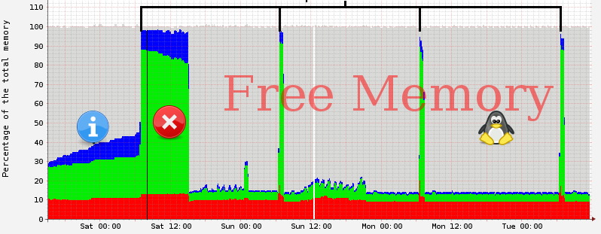
Introduction to memory management
+ A part of a more general problem in programming called resource management.
+ When your program is running, it uses resources, and if you don’t practice cleanliness, some resource will be used up, and your program will probably crash (example: memory)
+ Memory management is a hard problem.

Slide 35
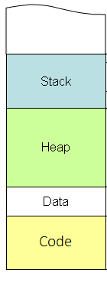
Types of memory
func(){
int local = 10;
int *pInt= &local;
}
Static allocation
Local variable
Automatically alloc/delloc
Dynamic allocation
Dynamic variable
Manually alloc/delloc
int *dy = new int;
//or malloc, alloc
delete dv;
Static variable
Global variable
Automatically alloc/delloc
int global = 10;
static gs_var = 9;
char *s = “data”;
Machine source code
Automatic alloc/delloc

Slide 36

DyNamic allocation
An object is created by using dynamic allocation. It can have many pointers point to itself.
When an object’s useful life is over?
Cat* cat = new Cat();
cat->sayHello()
Cat* refCat = cat;
refCat->sayHello();
delete refCat;
cat->sayHello(); → cause error!

Slide 37
Reference counting
- Every object has an integer associated with it, known as its reference count or retain count.
MyClass* tracker = [MyClass new]; //count: 1
MyClass * refTracker = [tracker retain]; //count 2
MyClass * otherRefTracker = [tracker retain];// count 3
[refTracker release]; //count 2
[otherRefTacker release]; //count 1
[tracker release] ; //count 0, object will be destroyed. delloc will be called.

Slide 38
Object ownership
An Object with instance variables or properties that point to other objects is said to own those other objects. It means it is responsible for making sure the object gets cleaned up
int main() {
Engine * engine = [Engine new];
[car setEngine: engine]
}
- Who owns the engine now?
- Does main own it or does car?
- Who is responsible for making sure the Engine gets a release message when it is no longer useful?

Slide 39

Object ownership (CONT)
Car and main() are now using the engine.
Car should retain the engine inside setEngine.
main() should release the engine. Then Car releases the engine when it’s done (in its dealloc method)

Slide 40
Retaining and releasing in accessors
We have an implementation for setEngine
Try with code below:
- (void) setEngine: (Engine*) newEngine
{
Engine = [newEngine retain]; --> bad
}
engine1’s retain count is still 1. main() has already release, but car never did -> leak memory.
Engine * engine1 = [Engine new]; // retain count: 1
[car setEngine: engine1]; //retain count: 2
[engine1 release];// retain count: 1
Engine* engine2 = [Engine new]; //engine 2 retain count: 1
[car setEngine: engine2]; //oops! What happens with engien 1?

Slide 41
Retaining and releasing in accessors (CONT)
Here’s another implementation:
Try with code below:
- (void) setEngine: (Engine*) newEngine
{
[engine release]
Engine = [newEngine retain];
}
The first line of setEngine is [engine release], which makes the retain count 0, and the object gets deallocated
Engine *engine = [Engine new];//count 1
Car * car1 = [Car new];
Car * car2 = [Car new];
[car1 setEngine: engine]; //count 2
[engine release]; //count 1
[car2 setEngine: [car1 engine]]; //oops!

Slide 42
Retaining and releasing in accessors (CONT)
Here is a better way to write setEngine:
* For properties:
@properties (retain) NSString* firstName; //increase retain count
@properties (assign) NSString* lastName; //retain count don’t change
@properties (copy) NSString* age; // create a new copy with retain count 1.
- (void) setEngine: (Engine*) newEngine{
[newEngine retain]
[engine release]
Engine = newEngine;
}

Slide 43
autorelease
Who is responsible for cleaning up this string object?
For an example:
- (NSString*) description
{
NSString* desc = [[NSString alloc] initWithString: @”Object description”];
return desc;
}
It makes using the descriptions extremely inconvenient
NSString desc = [someObject description] ;
NSLog(@”%@”, desc);
[desc release]

Slide 44
Autorelease (CONT)
NSObject provides a method called autorelease
This method schedule a release to be sent at some time in the future.
So we can now write a description method like below:
- (id) autorelease;
- (NSString*) description
{
NSString* desc = [[[NSString alloc] initWithString: @”Object description”] autorelease];
return desc;
}
//we can use
NSLog(@”%@”, [someObject description]);

Slide 45
Autorelease pool
When you send autorelease to an object is that the object is added to an NSAutoreleasePool, when that pool is destroyed, all the objects in the pool are sent a release message.
NSAutoreleasePool * pool = [[NSAutoreleasePool alloc] init];
//All autorelease messages place here, will be add to pool and will be release after it releases.
[pool release];

Slide 46
Transient Objects
If you get the object from new, alloc, or copy, you need to release them.
If you get the object from any other mechanism, such as arrayWithCapacity, you don’t have to worry about destroying it
NSMutableArray * array = [[NSMutableArray alloc] init]; //count 1
//use array
[array release]; // count 0
NSMutableArray * array = [NSMutableArray arrayWithCapacity: 17]; //count 1, autoreleased
//or
NSColor * color = [NSColor redColor];

Slide 47
Transient Objects (CONT)
Important:
When you are writing a GUI application, Cocoa creates an autorelease pool before event starts, and destroys the pool after the event is handled. So if your transient objects be created in event, it might be destroyed.
In this case, if you don’t want your transient objects to destroy, you need to remember to retain it and release when you’re done with it.

Slide 48
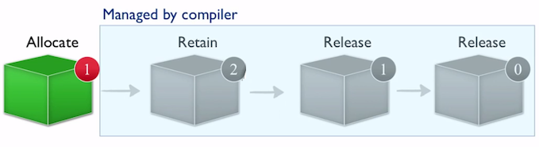
Introduction to ARC
- Automatic Reference Counting (ARC) is a compiler feature that provides automatic memory management of Objective-C.
- ARC works by adding code at compile time to ensure that objects live as long as necessary, but no longer.
- ARC is supported in Xcode 4.2 from OSX 10.6 and iOS 4.
- You can enable/disable ARC using a new -fobjc-arc/-fno-objc-arc compiler flag.

Slide 49
New Lifetime Qualifiers WITH ARC
// The following declaration is a synonym for: @property(retain) MyClass *myObject;
@property(strong) MyClass *myObject;
// The following declaration is similar to "@property(assign) MyClass *myObject;”
// except that if the MyClass instance is deallocated,
// the property value is set to nil instead of remaining as a dangling pointer.
@property(weak) MyClass *myObject;
Under ARC, strong is the default for object types.

Slide 50
Strong Ownership & Responsibility
Person Object 1
@properties (strong) NSString* name
@”Torres”
@”Henry”
Person Object 2
@properties (strong) NSString* name

Slide 51
WEAK Ownership & Responsibility
Person Object 3
@properties (strong) NSString* name
@”Torres”
@”Henry”
Person Object 4
@properties (weak) NSString* name
nil

Slide 52
strong reference cycle
Person Object 1
@properties (strong) Person* friend
Person Object 2
@properties (strong) Person* friend

Slide 53
New Lifetime Qualifiers WITH ARC (CONT)
__strong is the default. An object remains “alive” as long as there is a strong pointer to it.
__weak specifies a reference that does not keep the referenced object alive. A weak reference is set to nil when there are no strong references to the object.
__unsafe_unretained likes weak, but it is not set to nil when there are no strong references to the object.
__autoreleasing is used to denote arguments that are passed by reference (id *) and are autoreleased on return.
Read more: https://developer.apple.com/library/mac/releasenotes/ObjectiveC/RN-TransitioningToARC/Introduction/Introduction.html

Slide 54
Introduction to foundation kit

Slide 55
Introduction to Foundation Kit
- Foundation Kit has a bunch of useful low-level, data-oriented classes and types.
- We’ll be visiting a number of these, such as NSString, NSArray, NSNumber and NSNull.
- To use Foundation Kit, just
import <Foundation/Foundation.h>

Slide 56
NSString
Method creates a new NSString with format and arguments:
- Some other methods:
+ (id) stringWithFormat: (NSString*) format, … ;
Example:
NSString * sheight = [NSString stringWithFormat: @”Your height is %f m”, 1.7f];
- (BOOL) isEqualToString: (NSString*) aString;
- (NSComparisionResult) compare: (NSString*) aString;
- (unsigned int) length;

Slide 57
Mutability string
- NSString are immutable, that doesn’t mean you can’t keep them quiet, it refers to the face that once they’re created, you can’t change them.
- Foundation Kit provides a subclass of NSString called NSMutableString. Use if you want to edit a string
+ (id) stringWithCapacity: (unsigned) capacity;
+ (id) string;
- (void) appendString: (NSString*) aString;
- (void) appendFormat: (NSString*) format,… ;

Slide 58
NSArray
- NSArray is a Foundation class that holds an ordered list of objects. You can put any kind of objects in an NSArray: NSString, Car, Shape, etc.
- NSArray has two limitations:
+ It will only hold Objective-C objects. You can’t have primitive C types, like int, float, enum, struct or random pointers.
+ You can’t store nil or NULL value for objects in an NSArray.
NSArray* array = [NSArray arrayWithObjects: @”one”, @”two”, @”three”, nil];
//Other methods
- (id) objectAtIndex: (unsigned int) index;
- (id) indexOjObject: (id) aObject;

Slide 59
Mutability array
- The Foundation Kit provides a NSMutableArray class are mutable. You can add, remove objects whenever you want.
- Some method for working with NSMutableArray:
- (id) array;
- (void) addObject: (id) anObject;
- (void) removeObjectAtIndex: (unsigned int) index;
- (void) insertObjectAtIndex: (unsigned int) index;

Slide 60
NSNumber
Foundation Kit provides a class called NSNumber that wraps the primitive numeric types. You can create a new NSNumber using these class methods:
Once you have a primitive type wrapped in an NSNumber, you can get it back out by using one of these instance methods:
+ (NSNumber *) numberWithChar: (char) value;
+ (NSNumber *) numberWithInt: (int) value;
+ (NSNumber *) numberWithFloat: (float) value;
+ (NSNumber *) numberWithBool: (BOOL) value;
- (char) charValue;
- (int) intValue;
- (float) floatValue;
- (BOOL) boolValue;
- (NSString*) stringValue;

Slide 61
NSNull
NSNull is probably the simplest of all Objective-C class, it has but a single method:
+ (NSNull *) null;

Slide 62
MIXing objective C with C++

Slide 63
Integrate with C/C++
Objective-C is a superset of the C programming language.
You can write code C in Objective-C file (*.m).
You can write code C++ in Objective-C++ (*.mm).
It causes error if you include header C++ class file into header Objective-C class file.

Slide 64
Call C++ method from Objective-c
C++, we have a Game class as below:
Objective-C, we have a Device class:
class Game{
public:
void Update(){
printf(”Update from C++");
}
};
@interface Device : NSObject
- (void) Update;
@end

Slide 65
Call C++ method from Objective-c (CONT)
Now, when update of device, we need to call update of game
#import "Device.h"
#import "Game.h”
@implementation Device{
Game game; //declare a variable instance
}
- (void) Update{
game.Update();//call game update
}
@end
Device * device;//declare device as global variable
int main() {
device = [[Device alloc] init];
[device Update];
}

Slide 66
Call Objective-C from C++
Now, at Update of Game, we need to open web browser:
And we will implement OpenBrowser at .mm file
class Game{
public:
void Update(){
printf("Update from C++\n");
OpenBrowser();//open Browsers
}
void OpenBrowser();//Forward declare
};

Slide 67
Call Objective-C from C++ (CONT)
#import "Device.h"
#import "Game.h”
@implementation Device{
Game game; //declare a variable instance
}
- (void) Update{
game.Update();//call game render
}
- (void) OpenBrowser{
NSLog(@"Browser is opened from Device");
}
@end
extern Device * device;
void Game::OpenBrowser(){
[device OpenBrowser]; //call open browser
}

Slide 68
Call Objective-C from C++ (CONT)
To make clearly, we usually create a wrapper for calling from C++
struct Wrapper;//forward declare
class Game
{
public:
Wrapper* wrapper; //declare a wrapper class
void Update()
{
printf("Update from C++\n");
OpenBrowser();//open Browsers
}
void OpenBrowser();//Forward declare
Game();
~Game();
};

Slide 69
Call Objective-C from C++ (CONT)
We will implement class WrapperImpl to open web browser as below:
#import "WrapperImpl.h”
@implementation WrapperImpl
(void) openBrowser
{
NSLog(@"Open Browser from Wrapper Implementation");
}
@end

Slide 70
Call Objective-C from C++ (CONT)
Next, we create .mm file, to implement these declare methods of Game class and Wrapper struct as below:
#import "WrapperImpl.h"
#import "Game.h”
struct Wrapper{ //declare wrapper struct
WrapperImpl* impl;
};
Game::Game(){ //Implement these forward game methods
wrapper = new Wrapper();
wrapper->impl = [[WrapperImpl alloc] init];
}
void Game::OpenBrowser{
[wrapper->impl openBrowser];//call openBrowser
}
Game::~Game(){
delete wrapper;
}

Slide 71

Question & answer

Slide 72


